Slide 1



Streaming for Aibohphobes: Longest Near-Palindrome under Hamming Distance
Elena Grigorescu, Purdue University
Erfan Sadeqi Azer, Indiana University
Samson Zhou, Purdue University

Slide 2
Structure of Talk
Background
1-Pass Additive Algorithm
2-Pass Exact Algorithm
Lower Bounds
Alignments

Slide 3



Palindrome
A string that reads the same forwards and backwards
$S=S^{R}$
RACECAR
RACECAR
AIBOHPHOBIA
AIBOHPHOBIA

Slide 4


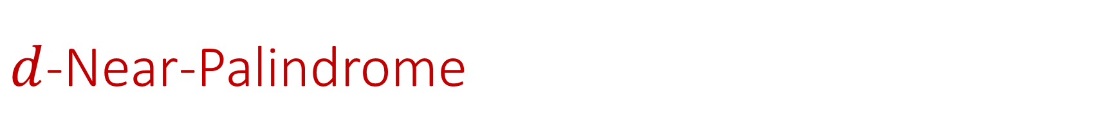
$d$-Near-Palindrome
A string that “almost” reads the same forwards and backwards
Given a metric $dist$, a $d$-near-palindrome has $dist\left(S,S^{R}\right)≤d$.
RACECAR
FACECAR

Slide 5

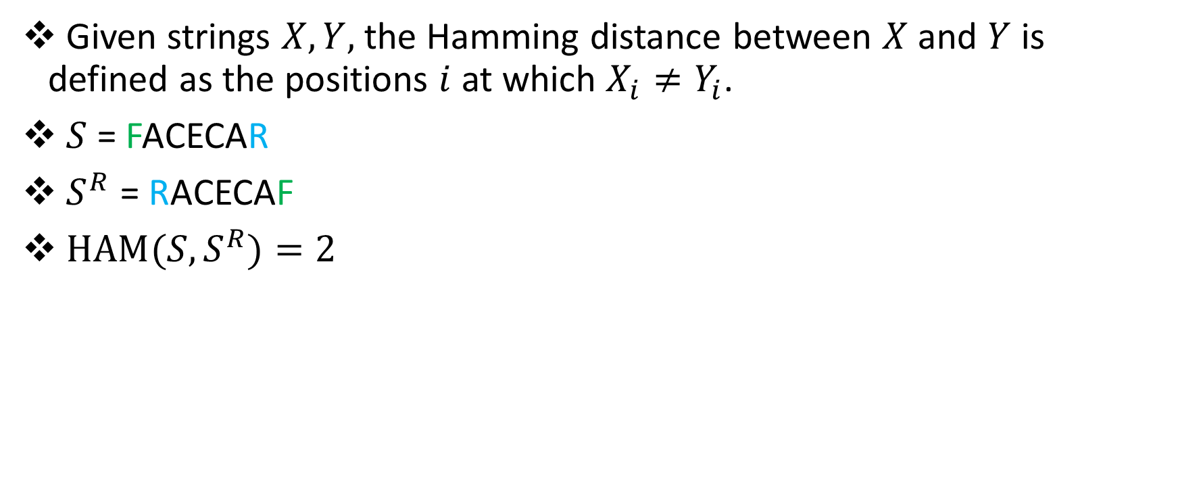
Hamming Distance
Given strings $X, Y,$ the Hamming distance between $X$and $Y$ is defined as the positions $i$ at which $X_{i}≠Y_{i}$.
$S$ = FACECAR
$S^{R}$ = RACECAF
${HAM(S,S}^{R})=2$

Slide 6


Streaming Model
String of length $n$ arrives one symbol at a time
Use $o(n)$ space, ideally $O(polylog n)$
111101011100001010010101001

Slide 7
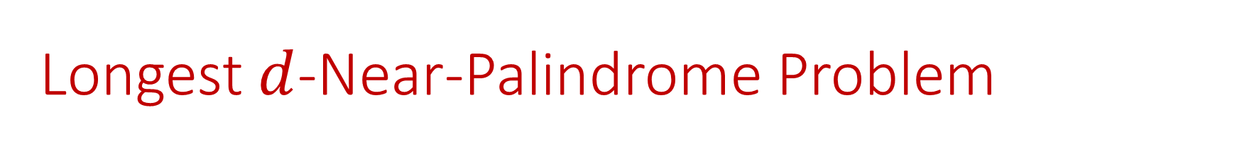
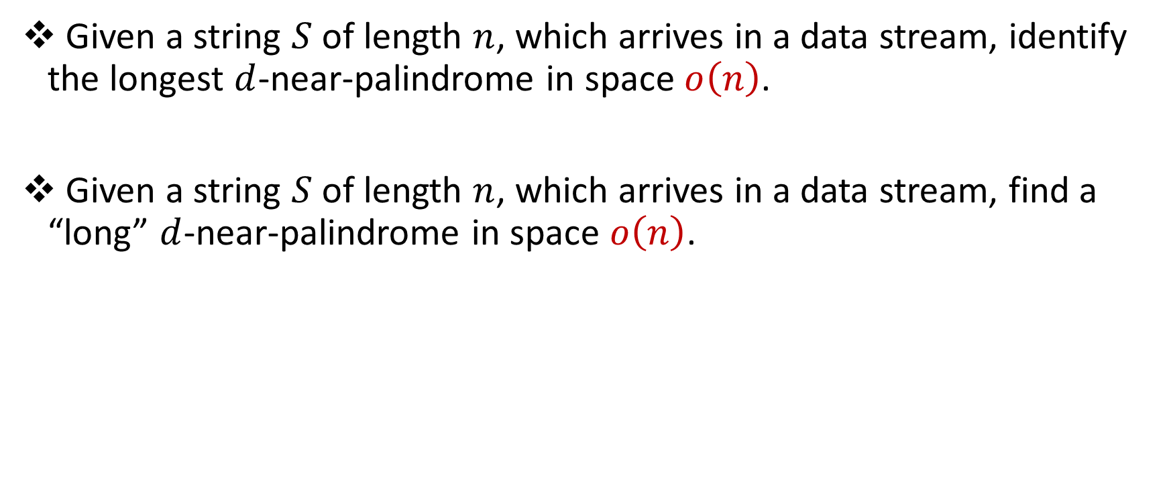
Longest $d$-Near-Palindrome Problem
Given a string $S$ of length $n$, which arrives in a data stream, identify the longest $d$-near-palindrome in space $o\left(n\right)$.
Given a string $S$ of length $n$, which arrives in a data stream, find a “long” $d$-near-palindrome in space $o\left(n\right)$.

Slide 8

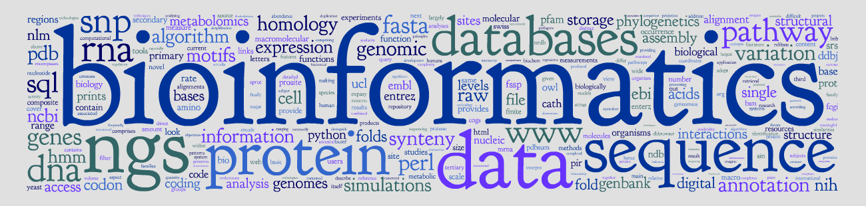
Applications

Slide 9

Applications

Slide 10

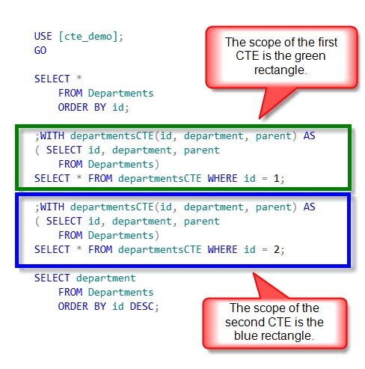
Applications
Queries used to compute transitive closures in SQL have recursive structure
Access patterns can be used to identify the location of errors in queries

Slide 11
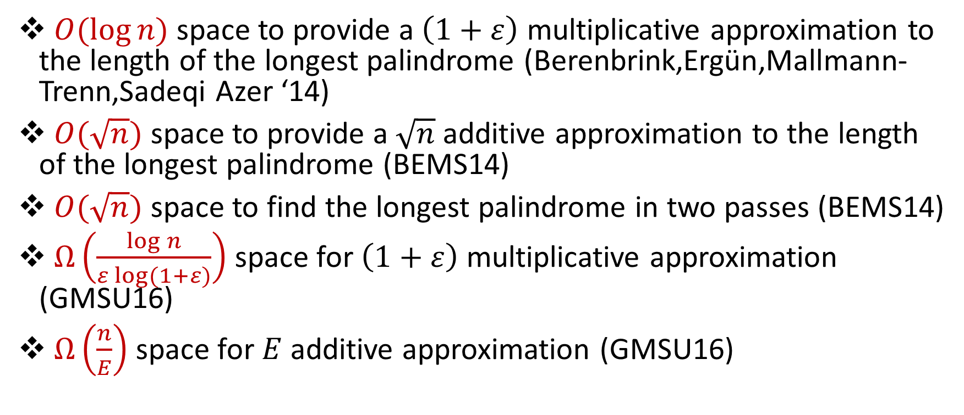
Related Work
$O(\log{n)}$ space to provide a $\left(1+ε\right)$ multiplicative approximation to the length of the longest palindrome (Berenbrink,Ergün,Mallmann-Trenn,Sadeqi Azer ‘14)
$O(\sqrt{n})$ space to provide a $\sqrt{n}$ additive approximation to the length of the longest palindrome (BEMS14)
$O(\sqrt{n})$ space to find the longest palindrome in two passes (BEMS14)
$Ω\left(\frac{\log{n}}{ε log⁡(1+ε)}\right)$ space for $\left(1+ε\right)$ multiplicative approximation (GMSU16)
$Ω\left(\frac{n}{E}\right)$ space for $E$ additive approximation (GMSU16)

Slide 12
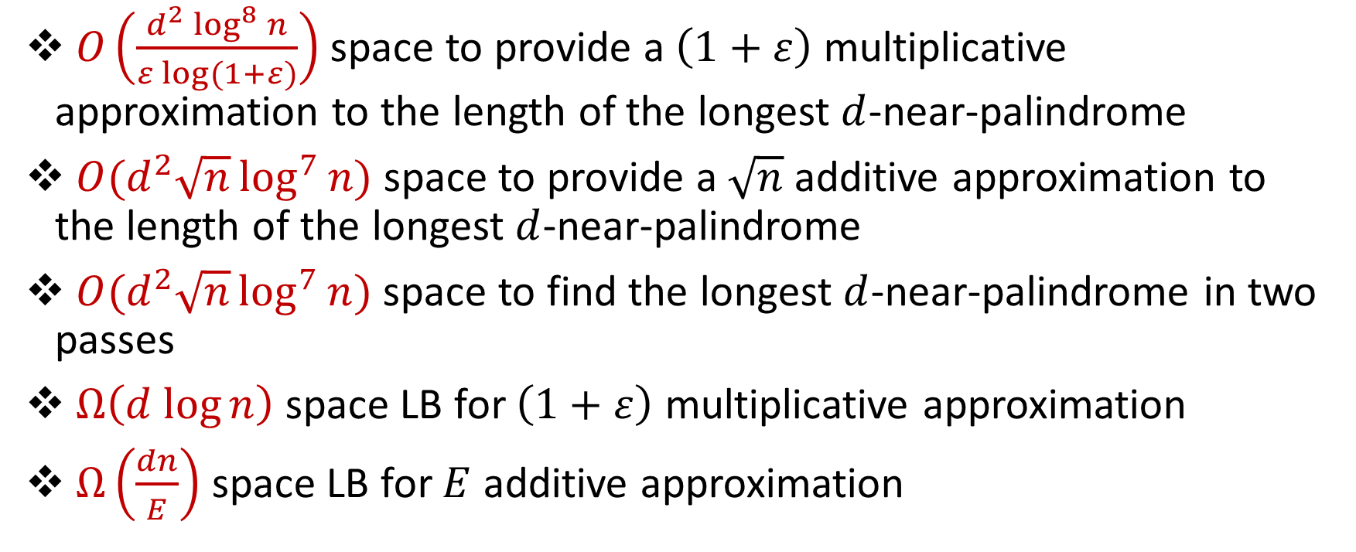
Our results
$O\left(\frac{d^{2} \log^{8}{n}}{ε log⁡(1+ε)}\right)$ space to provide a $\left(1+ε\right)$ multiplicative approximation to the length of the longest $d$-near-palindrome
$O(d^{2}\sqrt{n}\log^{7}{n})$ space to provide a $\sqrt{n}$ additive approximation to the length of the longest $d$-near-palindrome
$O(d^{2}\sqrt{n}\log^{7}{n})$ space to find the longest $d$-near-palindrome in two passes
$Ω\left(d log{n}\right)$ space LB for $\left(1+ε\right)$ multiplicative approximation
$Ω\left(\frac{dn}{E}\right)$ space LB for $E$ additive approximation

Slide 13
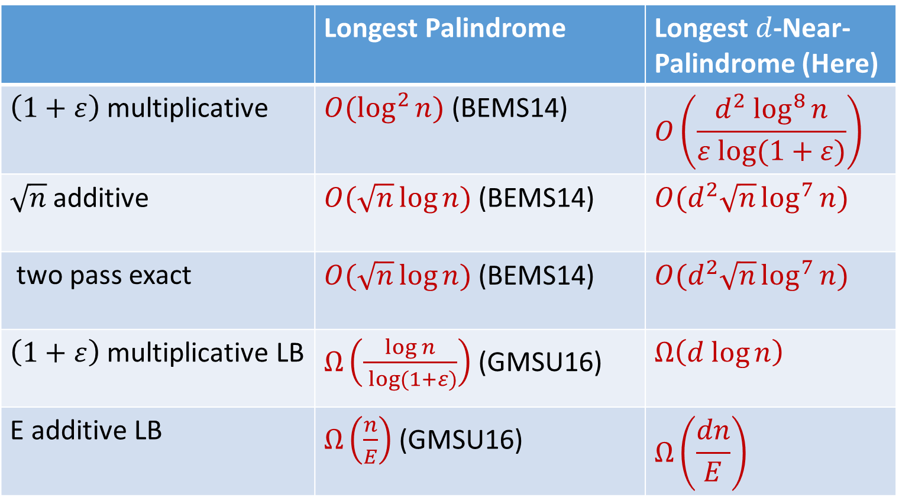
Comparison
 | Longest Palindrome | Longest $d$-Near-Palindrome (Here)
$\left(1+ε\right)$ multiplicative | $O(\log^{2}{n)}$ (BEMS14) | $$O\left(\frac{d^{2} \log^{8}{n}}{ε log⁡(1+ε)}\right)$$
$\sqrt{n}$ additive | $O(\sqrt{n}\log{n})$ (BEMS14) | $O(d^{2}\sqrt{n}\log^{7}{n})$
two pass exact | $O(\sqrt{n}\log{n})$ (BEMS14) | $O(d^{2}\sqrt{n}\log^{7}{n})$
$\left(1+ε\right)$ multiplicative LB | $Ω\left(\frac{\log{n}}{ log⁡(1+ε)}\right)$ (GMSU16) | $$Ω\left(d log{n}\right)$$
E additive LB | $Ω\left(\frac{n}{E}\right)$ (GMSU16) | $$Ω\left(\frac{dn}{E}\right)$$

Slide 14
Structure of Talk
Background
1-Pass Additive Algorithm
2-Pass Exact Algorithm
Lower Bounds
Alignments

Slide 15


Warm-up
Suppose we see string $S$, followed by string $T$. How can we determine if $S=T$, with high probability?

Slide 16


Karp-Rabin Fingerprints
Given base $B$and a prime $P$, define $φ\left(S\right)=\sum_{i=1}^{n}{B^{i}S\left[i\right] \left(mod P\right)}$
If $S=T$, then $φ\left(S\right)=φ\left(T\right)$
If $S≠T$, then $φ\left(S\right)≠φ\left(T\right)$ w.h.p. (Schwartz-Zippel)

Slide 17

Properties of Karp-Rabin Fingerprints
$φ\left(S[1:y]\right)=φ\left(S[1:x]\right)+B^{x}φ\left(S[x:y]\right)$
Define $φ^{R}\left(S\right)=\sum_{i=1}^{n}{B^{−i}S\left[i\right] \left(mod P\right)}$
$φ\left(S^{R}[1:x]\right)=B^{x+1}φ^{R}\left(S[1:x]\right)$
$φ^{R}\left(S[1:y]\right)=φ^{R}\left(S[1:x]\right)+B^{−x}φ^{R}\left(S[x:y]\right)$

Slide 18


Identifying Palindromes
111101011100001010010101001111101011100001010010101001
111101011100001010010101001111101011100001010010101001

Slide 19

Identifying Near-Palindromes?
111101011100001010010101001111101011100001010010101001
111101011100001010010101001111101011100001010010101001

Slide 20
Identifying Near-Palindromes?
111101011100001010010101001111101011100001010010101001
111101011100001010010101001111101011100001010010101001

Slide 21
Identifying Near-Palindromes? (CFP+16)

Slide 22
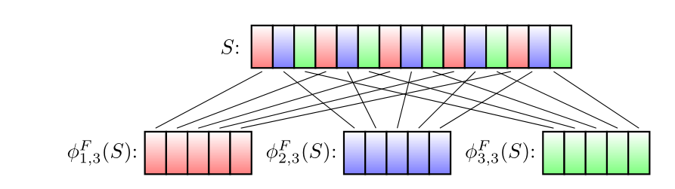

Karp-Rabin Fingerprints for subpatterns
$S_{a,b}=S\left[a\right]S\left[a+b\right]S\left[a+2b\right]S\left[a+3b\right]…$
$φ_{a,b}\left(S\right)=φ\left(S_{a,b}\right)=B∗S\left[a\right]+B^{2}∗S\left[a+b\right]+B^{3}∗S\left[a+2b\right]…$

Slide 23

Identifying Near-Palindromes?
Let $∆ =\#\left\{a \right|{ φ}_{a,b}\left(S\right)≠{B^{k}φ}_{a,b}^{R}\left(S\right) (mod P)\}$
Then $∆ ≤HAM(S,S^{R})$

Slide 24



Identifying Near-Palindromes?
What about
$HAM\left(S,S^{R}\right)≤2d$?
Sample $\log{n}$ primes $p_{1},p_{2},…$ from $\left[16 d\log^{2}{n, 544 d\log^{2}{n}}\right]$.
Let $∆ =max \#\left\{a \right|{ φ}_{a,p_{i}}\left(S\right)≠{B^{k}φ}_{a,p_{i}}^{R}\left(S\right) (mod P)\}$
$∆ ≤HAM(S,S^{R})$
If $HAM\left(S,S^{R}\right)>2d$, then $∆ >\left(1+\frac{1}{16}\right) d$ w.h.p. (CFP+16)

Slide 25
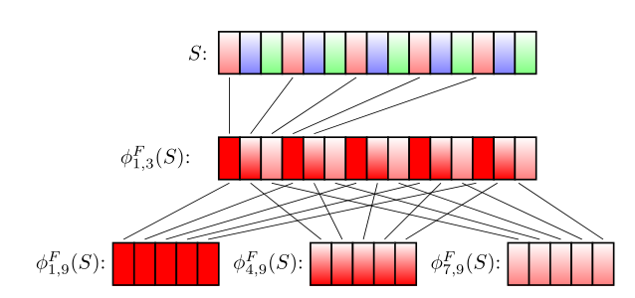
Karp-Rabin Fingerprints for sub-subpatterns

Slide 26


Second level Karp-Rabin Fingerprints
Call a mismatch isolated under $p_{i}$ if it is the only mismatch under some subpattern $S_{a,p_{i}}$. Let $I$ be the number of isolated mismatches.
If $HAM\left(S,S^{R}\right)≤2d$, then $I=HAM\left(S,S^{R}\right)$ w.h.p. (CFP+16)

Slide 27


In review
There exists a data structure of size $O\left(d^{2}\log^{6}{n}\right)$ words which recognizes whether $HAM\left(S,S^{R}\right)≤d$ w.h.p.

Slide 28
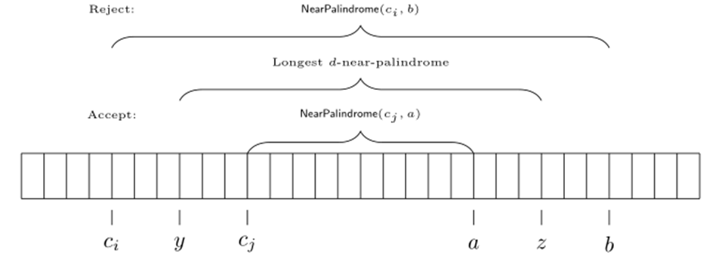

Additive Error Algorithm
Initialize a data structure every $\frac{\sqrt{n}}{2}$ positions!

Slide 29


Additive Error Algorithm
$\frac{\sqrt{n}}{2}$ sketches, each of size $O\left(d^{2}\log^{6}{n}\right)$ words
Total space: $O\left(d^{2}\sqrt{n}\log^{7}{n}\right)$ bits

Slide 30
Structure of Talk
Background
1-Pass Additive Algorithm
2-Pass Exact Algorithm
Lower Bounds
Alignments

Slide 31
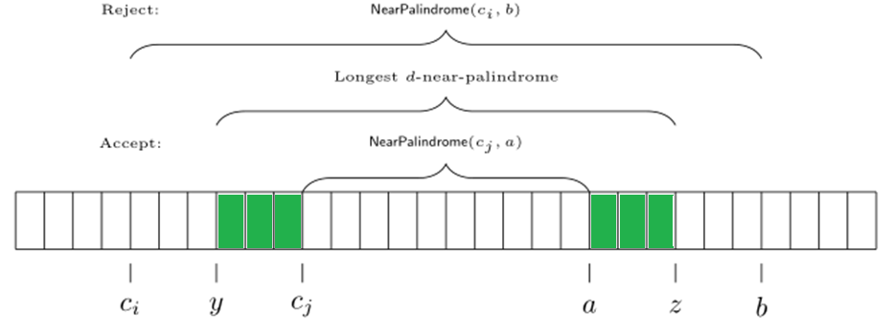
2-Pass Exact Algorithm
Can we modify 1-pass additive algorithm to 2-pass exact?
Missing characters before checkpoint!

Slide 32

2-Pass Exact Algorithm
Idea: keep all characters before each checkpoint in the second pass
What if there are $O\left(n\right)$ candidates?
Structural result of palindromes (BEMS14)

Slide 33
Structural Result of Palindromes (BEMS14)

Slide 34
Structural Result of Palindromes (BEMS14)

Slide 35
Structural Result of Palindromes (BEMS14)

Slide 36
Structural Result of Palindromes (BEMS14)

Slide 37
Structural Result of Palindromes (BEMS14)

Slide 38
Structural Result of Palindromes (BEMS14)

Slide 39
Structural Result of Palindromes (BEMS14)

Slide 40

Structural Result of Near-Palindromes
Not quite periodic (at most $2d−1$ different words)
Need to save at most $2d−1$ fingerprints of words

Slide 41
2-Pass Exact Algorithm
Not quite periodic (at most $2d−1$ different words)
Need to save at most $2d−1$ fingerprints of words

Slide 42


2-Pass Exact Algorithm
First pass: $O\left(d^{2}\sqrt{n}\log^{7}{n}\right)$ bits
At most $2d−1$ fingerprints, each of size $O\left(d^{2}\log^{6}{n}\right)$ words
Need to save at $\sqrt{n}$ characters before $2d−1$ checkpoints: $O\left(d\sqrt{n}\right)$
Total space: $O\left(d^{2}\sqrt{n}\log^{7}{n}\right)$ bits

Slide 43
Structure of Talk
Background
1-Pass Additive Algorithm
2-Pass Exact Algorithm
Lower Bounds
Alignments

Slide 44
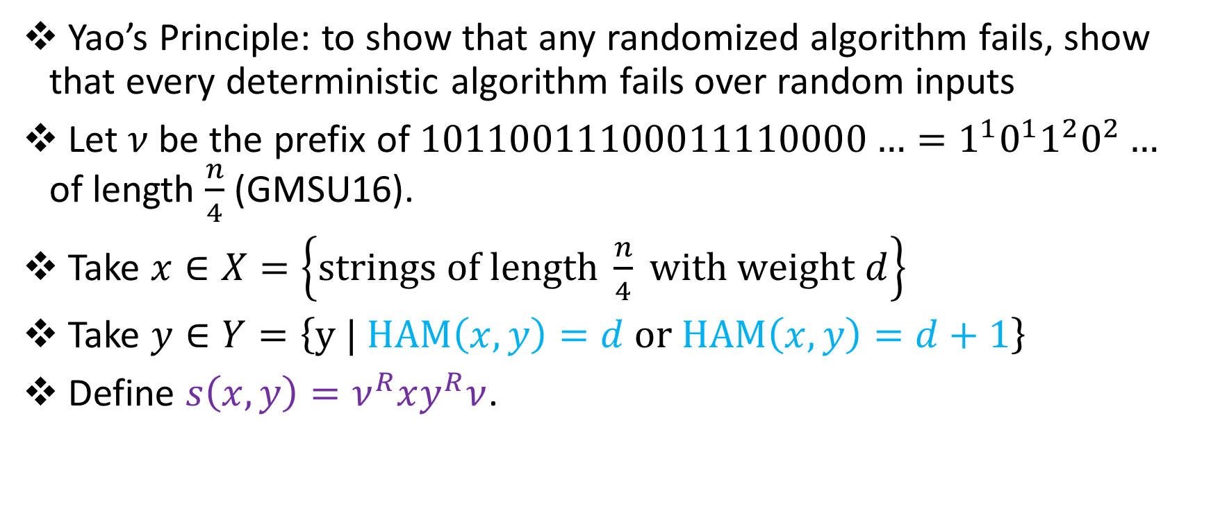
Multiplicative Lower Bounds
Yao’s Principle: to show that any randomized algorithm fails, show that every deterministic algorithm fails over random inputs
Let $ν$ be the prefix of $10110011100011110000…=1^{1}0^{1}1^{2}0^{2}…$ of length $\frac{n}{4}$ (GMSU16).
Take $x∈X=\left\{strings of length \frac{n}{4} with weight d\right\}$
Take $y∈Y=\left\{y | HAM\left(x,y\right)=d or HAM\left(x,y\right)=d+1\right\}$
Define $s\left(x,y\right)=ν^{R}xy^{R}ν$.

Slide 45
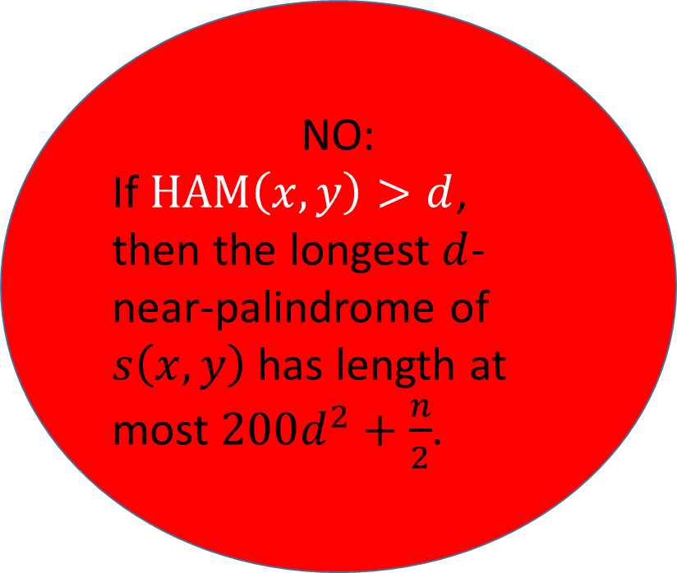
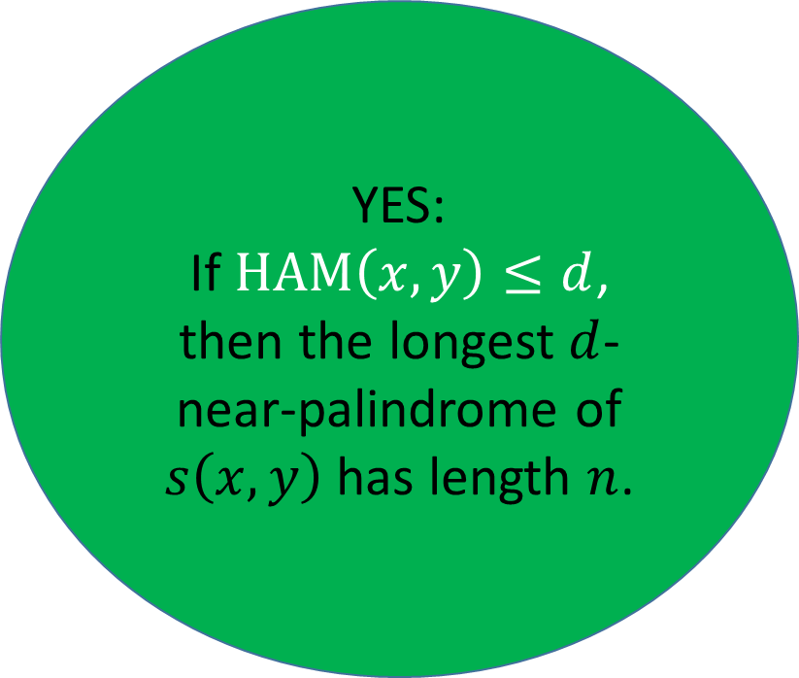
Multiplicative Lower Bounds
YES:
If $HAM\left(x,y\right)≤d$, then the longest $d$-near-palindrome of $s\left(x,y\right)$ has length $n$.
NO:
If $HAM\left(x,y\right)>d$, then the longest $d$-near-palindrome of $s\left(x,y\right)$ has length at most $200d^{2}+\frac{n}{2}$.

Slide 46

Multiplicative Lower Bounds
A $\left(1+ε\right)$ multiplicative algorithm differentiates whether $HAM\left(x,y\right)≤d$ or $HAM\left(x,y\right)>d$.
Just need to show cannot differentiate whether $HAM\left(x,y\right)≤d$ or $HAM\left(x,y\right)>d$ in $o(d\log{n)}$ space!

Slide 47


Multiplicative Lower Bounds
Save $x$ in $\frac{d\log{n}}{3}$ bits.
Since $x∈X=\left\{strings of length \frac{n}{4} with weight d\right\}$, there are $\frac{|X|}{4}$ pairs $(x,x^{′})$ which are mapped to the same configuration.

Slide 48
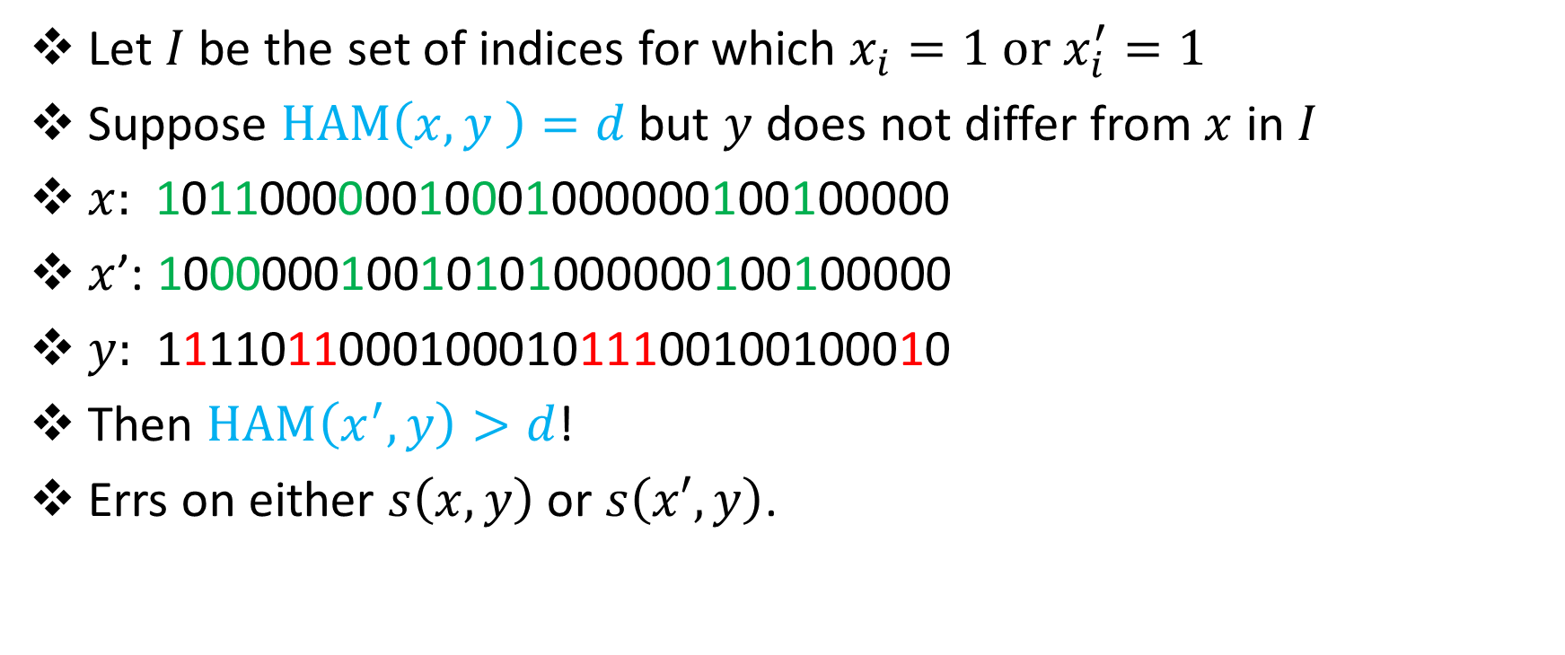
Multiplicative Lower Bounds
Let $I$ be the set of indices for which $x_{i}=1 or x_{i}^{′}=1$
Suppose $HAM\left(x,y \right)=d$ but $y$ does not differ from $x$ in $I$
$x:$ 101100000010001000000100100000
$x$’: 100000010010101000000100100000
$y:$ 111101100010001011100100100010
Then $HAM\left(x^{′},y\right)>d$!
Errs on either $s\left(x,y\right)$ or $s\left(x′,y\right)$.
???

Slide 49


Multiplicative Lower Bounds
There are $\frac{|X|}{4}$ values of $x$ mapped to the wrong configuration, each with $\left({\frac{n}{4} − 2d \atop d}\right)$ values of $y$, where algorithm is incorrect.
Probability of failure:
$$\frac{\frac{|X|}{4}\left({\frac{n}{4} − 2d \atop d}\right)}{\left|X\right||Y|}≥\frac{1}{n}$$

Slide 50
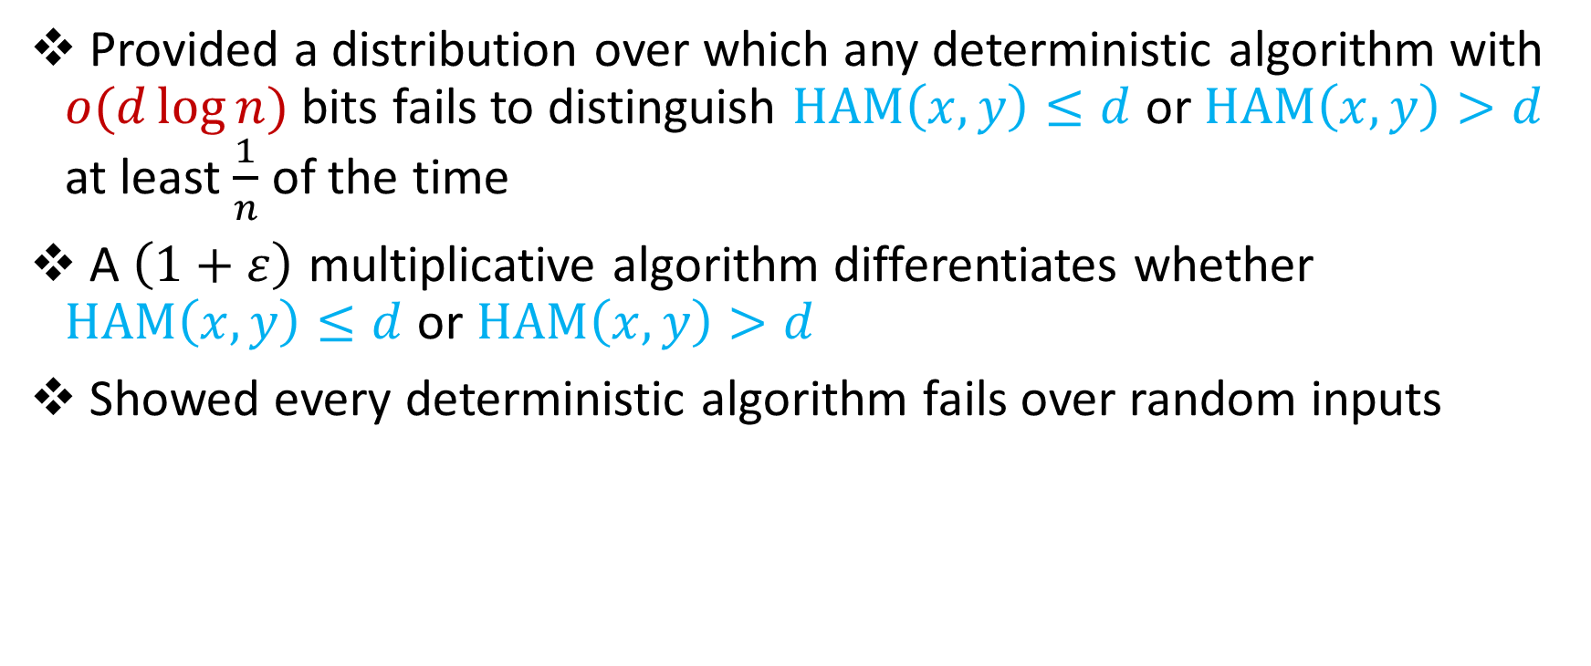
In review
Provided a distribution over which any deterministic algorithm with $o(d\log{n)}$ bits fails to distinguish $HAM\left(x,y\right)≤d$ or $HAM\left(x,y\right)>d$ at least $\frac{1}{n}$ of the time
A $\left(1+ε\right)$ multiplicative algorithm differentiates whether $HAM\left(x,y\right)≤d$ or $HAM\left(x,y\right)>d$
Showed every deterministic algorithm fails over random inputs

Slide 51
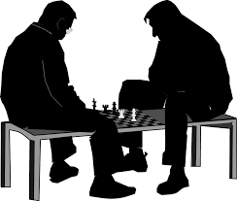

Additive Lower Bounds
Define $s\left(x,y\right)=1^{E}x_{1}1^{\frac{E}{d}}x_{2}1^{\frac{E}{d}}x_{3}…x_{\frac{n^{′}}{2}}y_{\frac{n^{′}}{2}}…y_{3}1^{\frac{E}{d}}y_{2}1^{\frac{E}{d}}y_{1}1^{E}$
Take $x∈X=\left\{all strings of length \frac{n^{′}}{2}\right\}$
Take $y∈Y=\left\{HAM\left(x,y\right)=d or HAM\left(x,y\right)=d+1\right\}$

Slide 52

Questions?

Slide 53
Structure of Talk
Background
1-Pass Additive Algorithm
2-Pass Exact Algorithm
Lower Bounds
Alignments

Slide 54

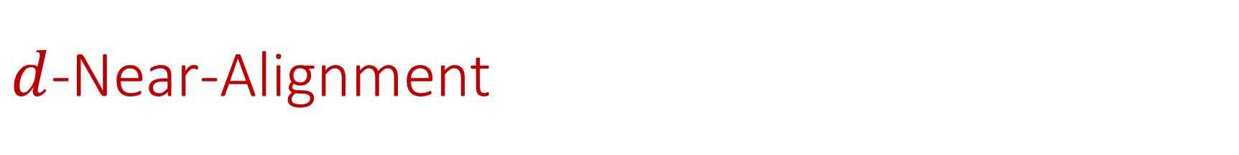
$d$-Near-Alignment
For strings $S$and $T$, indices $i,j$, and a metric $dist$: $S$and $T$ have a $d$-near-alignment of length $i−j+1$ if $dist\left(S[i,j],T[i,j] \right)≤d$.
$S=$ RACECAR
$T=$ FACECAR

Slide 55
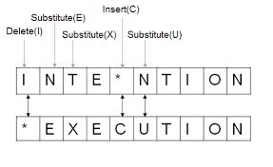
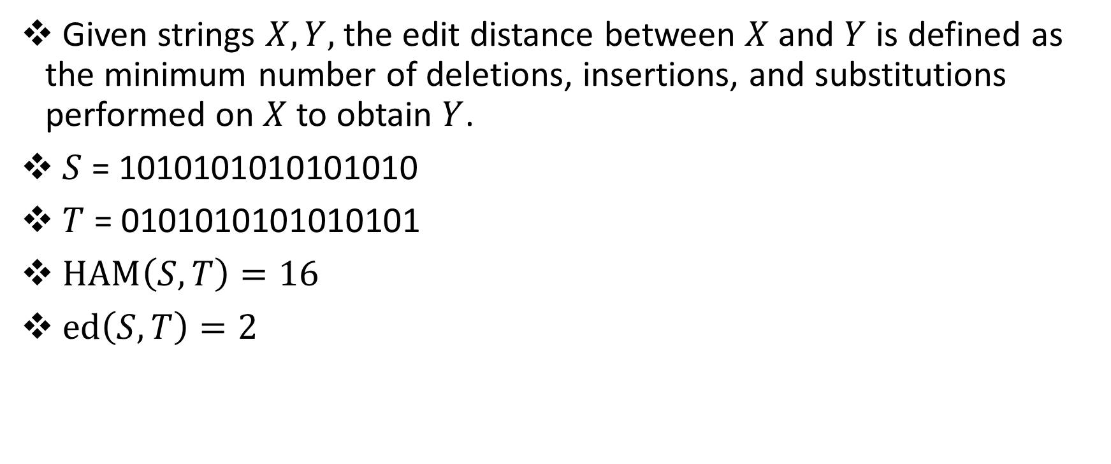
Edit (Levenshtein) Distance
Given strings $X, Y,$ the edit distance between $X$and $Y$ is defined as the minimum number of deletions, insertions, and substitutions performed on $X$ to obtain $Y$.
$S$ = 1010101010101010
$T$ = 0101010101010101
$HAM\left(S, T\right)=16$
$ed\left(S, T\right)=2$

Slide 56


Edit (Levenshtein) Distance
Classical offline solution: dynamic programming $O(n^{2})$ time (WF74)
Cannot be computed in $O(n^{2−δ})$ time assuming SETH (BI15)
Any linear sketch which distinguishes the cases $ed\left(x,y\right)=2$ and $ed\left(x,y\right)=1$ requires $Ω(n)$ space (AGMP13)

Slide 57
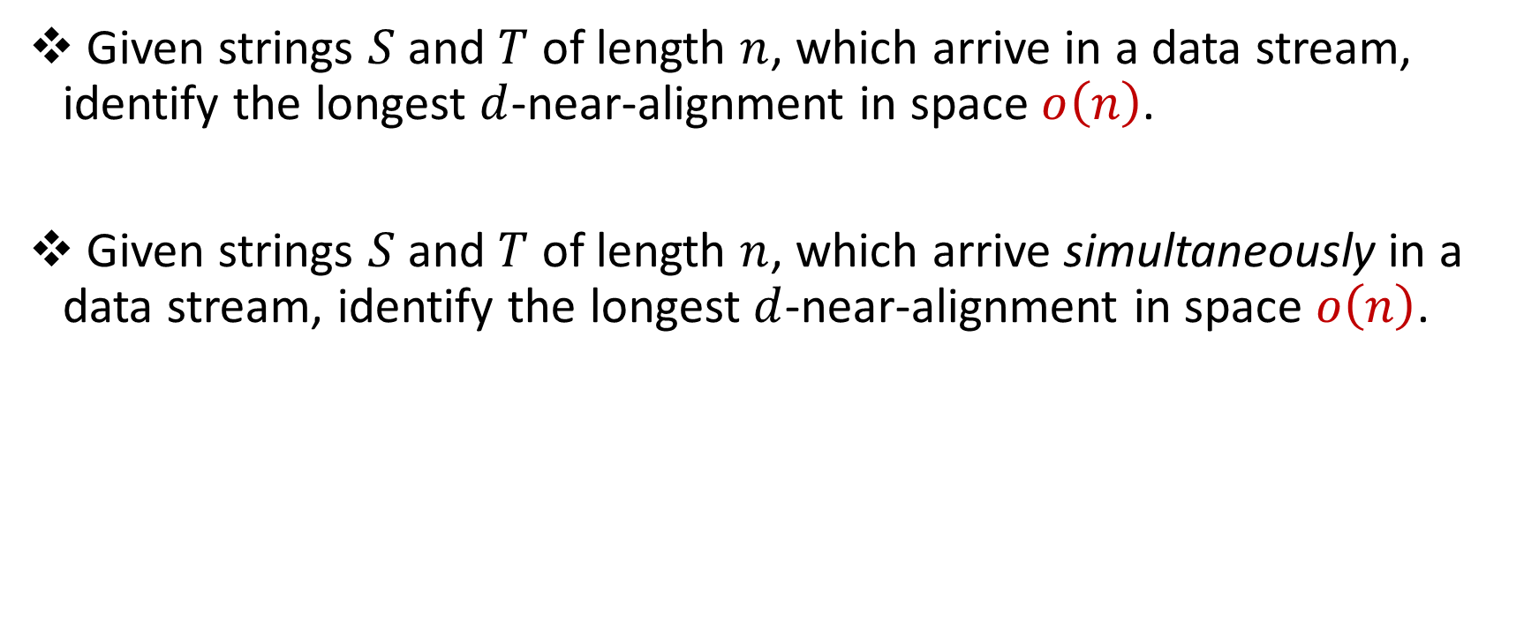
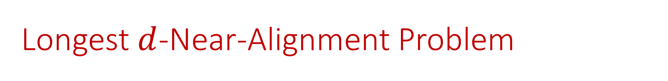
Longest $d$-Near-Alignment Problem
Given strings $S$ and $T$ of length $n$, which arrive in a data stream, identify the longest $d$-near-alignment in space $o\left(n\right)$.
Given strings $S$ and $T$ of length $n$, which arrive simultaneously in a data stream, identify the longest $d$-near-alignment in space $o\left(n\right)$.

Slide 58
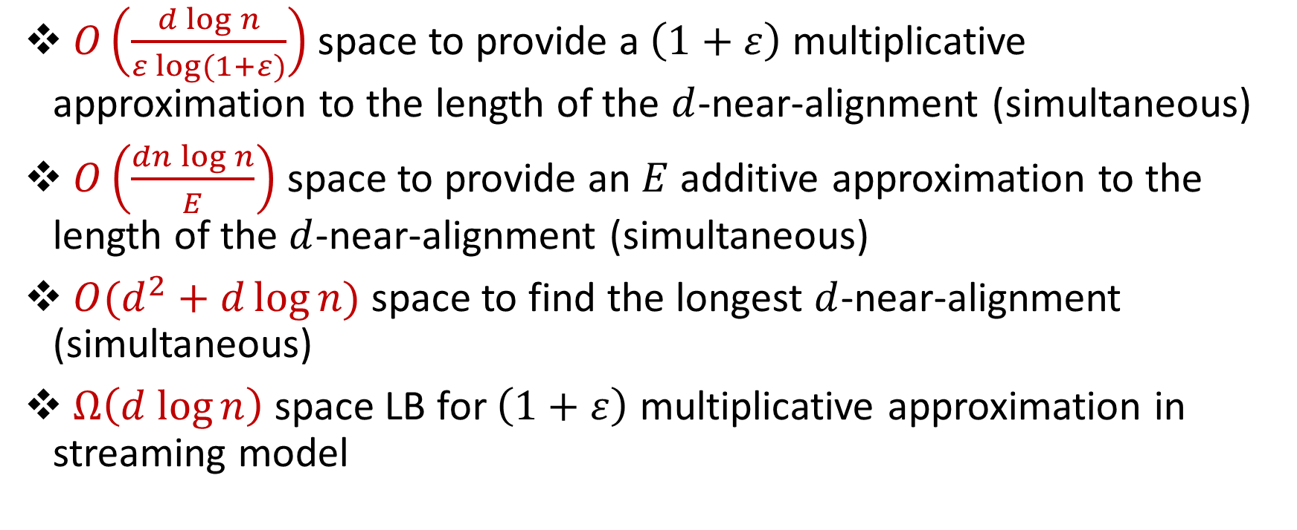
Results (All Edit Distance)
$O\left(\frac{d{\log{n}}}{ε log⁡(1+ε)}\right)$ space to provide a $\left(1+ε\right)$ multiplicative approximation to the length of the $d$-near-alignment (simultaneous)
$O\left(\frac{dn\log{n}}{E}\right)$ space to provide an $E$ additive approximation to the length of the $d$-near-alignment (simultaneous)
$O(d^{2}+d\log{n})$ space to find the longest $d$-near-alignment (simultaneous)
$Ω\left(d log{n}\right)$ space LB for $\left(1+ε\right)$ multiplicative approximation in streaming model

Slide 59


Longest $d$-Near-Alignment
Observation #1: If $d+1$ consecutive characters in $S$ are matched to $d+1$ consecutive characters in $T$, no character before the region can be matched to a character after the region by any other alignment

Slide 60


Longest $d$-Near-Alignment
Observation #2: If ${\left(d+1\right)}^{2}$ consecutive characters in $S$ and $T$does not contain a region (of length $d+1$), then it requires $d$ edit operations to be aligned

Slide 61

Longest $d$-Near-Alignment
Sliding window of size ${\left(d+1\right)}^{2}$ identifies either the most recent region or the most recent $d$ edit operations

Slide 62

Longest $d$-Near-Alignment
Algorithm keeps the most recent $d$ edit operations, location of the latest region, and the sliding window of size ${\left(d+1\right)}^{2}$
Edit operations before the region are fixed

Slide 63

Longest $d$-Near-Alignment
Window of size ${\left(d+1\right)}^{2}$
Locations of $d$ edit operations, each requiring space $O(\log{n)}$
Total space: $O(d^{2}+d log{n)}$

Slide 64

Open Problems
Can we find the longest $d$-near-palindrome in the edit distance?
Can we find the longest $d$-near-alignment in space $o(d^{2})$?
Longest palindromic subsequence

Slide 65


Slide 66
Questions?

